Slide 1

logo

Slide 2
SENIOR LEADERSHIP EXPERIENCE BUILT IN LEADING FORTUNE 500 COMPANIES AND TOP‑TIER INSTITUTIONS
Strengthen decisions. Sharpen priorities. Improve performance. Deliver results.
Senior finance leadership in close partnership with your leadership team from strategy through execution. We help you navigate growth, complexity, and uncertainty with greater clarity and confidence across markets, teams, and stakeholders.

Slide 3
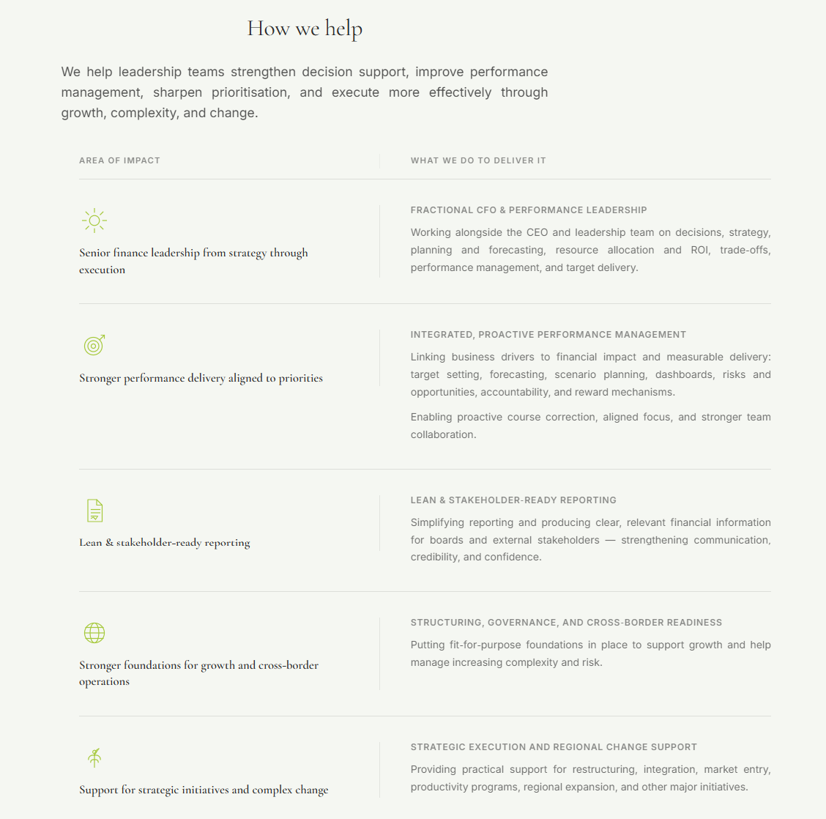

Slide 4
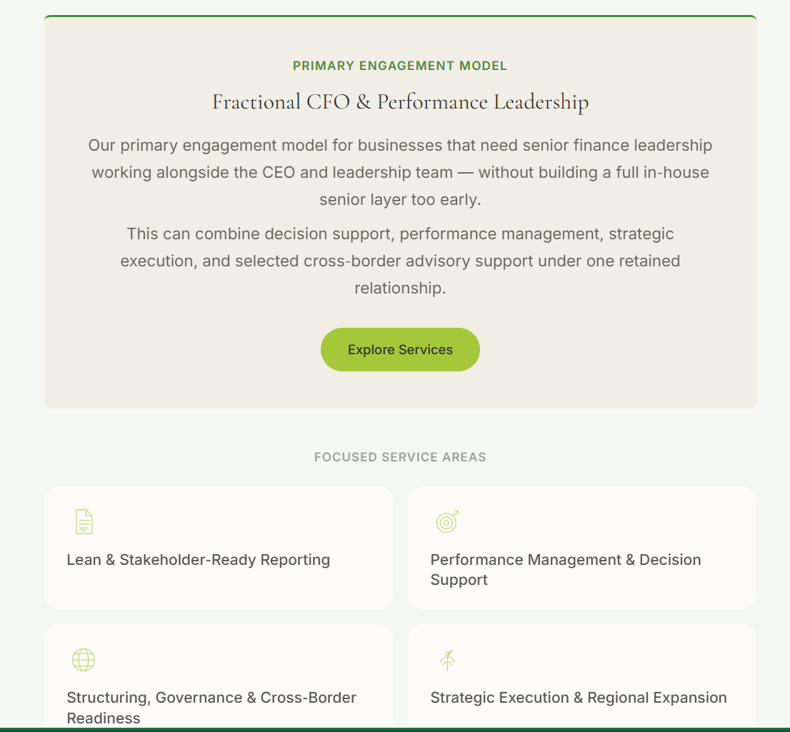

Slide 5

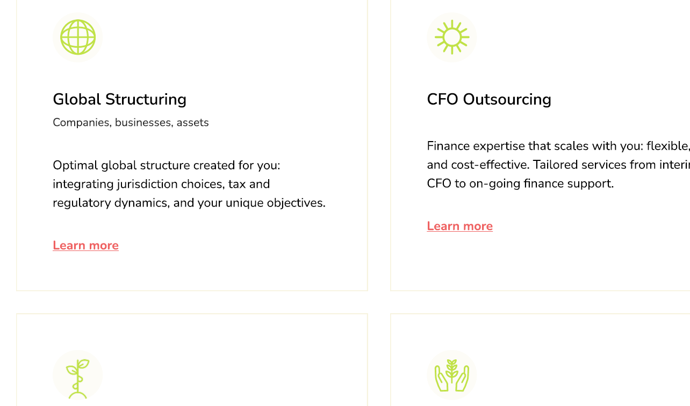

Slide 6
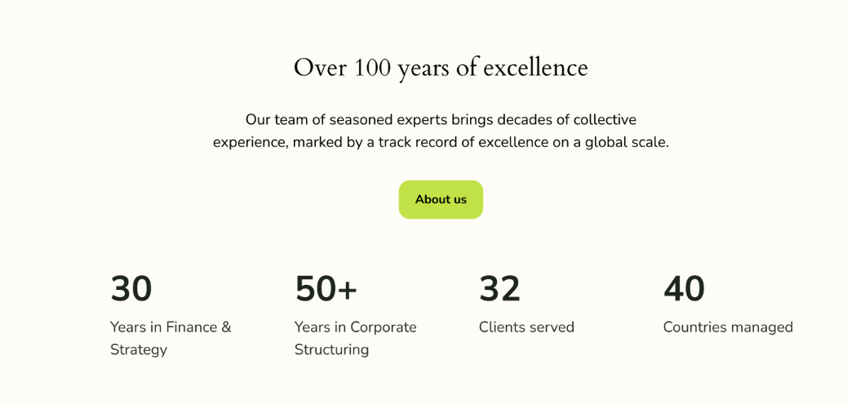
Asia expert
Decades of expertise, in-market operation and regional management in Asia, Across Finance, Strategy, corporate structuring, Transformation, and Business Consulting.
Global knowledge
Global perspective and a strong network built over decades working with MNCs, enterprises, family offices, and collaborating with diverse stakeholders and allies globally.
25+
Years in Business consulting
40+
Countries managed

Slide 7
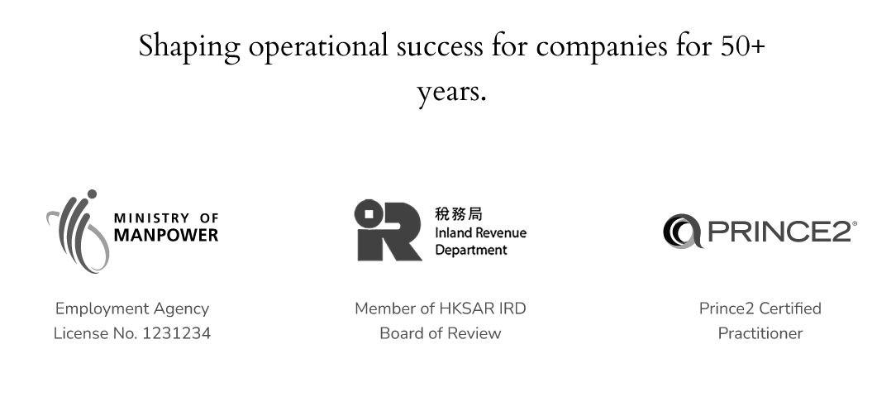




Exceptional Industry Reputation & track records
These are my Martner – IEP and trust lawyer’s credential
Director of Rothchild’s
trust companies
Adjunct Professor
of International Estate Planning
National University of Singapore
Executive Committee
Society of Trust and Estate Practitioners
(Hong Kong Branch)
Executive Committee
Hong Kong Trustees’ Association

Slide 8










These are companies I’ve worked with as senior international leader – CFO, Regional Finance Director, Regional Strategy Lead, Transformation lead,, company director,, various committee chairman and member. Please advise how best to display these on the website – as experience or companies we’ve worked with, or credibility of global leading companies (Mostly) and growing SMEs (- only 3: Kingfisher, Navitas, JCS)

Slide 9


These are clients my other partner has worked with

Slide 11
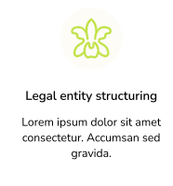
Corporate Structuring
Regulatory Reporting & Advisory
Full financial Reporting Services, SFRS, SFRS(I), IFRS(I), ACRA, IRAS, Company Act compliant
Directors’ Report, Financial Statements +Notes
Annual Return and tax filing
Pre-map compliance thresholds
Assess exemption scenarios
Offer Group Efficiency Package
Minimize clients burdens
Key benefits:
✓ Meet reporting requirement efficiently
✓ Simplify compliance
✓ Enable strategic choices, optimum protection, and disclosure controls.
X over-reporting
X data overload
X unnecessary disclosure
Corporate Structure & Services
Single or multiple types of entities and jurisdictions
Set-up and On-going Support
Legal entity structuring & set up
Corporate Services:
Company Secretary
Directorship
Regulatory Risk Mitigation
Regulatory & Financial Reporting
Local licenses and permits
Insurances
Recruitment
Employment Passes & Immigration – Singapore
Key benefits:
Limit liabilities from any potential lawsuits and financial losses.
Optimise tax by leveraging our international comparative tax knowledge.
Simplify Compliance to free up resources for growing business.
Attract investors with a structure internationally recognised for greater stability and transparency

Slide 12
Fractional CFO
On‑demand C‑suite finance leadership to steer strategy, scale operation, build capability. Innovative & pragmatic solutions tailored to specific needs.
Management / Board / Stakeholder Reporting
– Insightful & credible, enabling decision and execution agility and improving confidence of investors / stakeholders
Specific Purpose CFO
Investment proposal / financial projection
- Project Management (PRINCE 2 Practitioner)
Business Partnering - Cross-Functional Process / Deliverables Re-engineering
Business Partnering - Growth Initiatives
- Scenario modelling & planning
Post M&A Integration, Re-structuring
Building FP&A capability
Transformation
Strategy, Roadmap, Change Management
Organization / Finance structure and process mapping
Financial impact analysis: investment, costs, benefits
Project &n Transformation:
Productivity – Cost Optimization: Diagnostics, proposals, Roadmaps, change management, tracking
Planning, Budgeting, Forecasting
– Translating vision to strategies, operationalizing strategies to specific execution and performance targets.
Resource allocation / Investment prioritization / ROI
Business Insight & Performance Management
- Integrated Dashboard (KPIs identified & tracked)
- Business Model Insight
- Business Drivers (Revenue, Costs)
- Variance Analysis
- Profitability
- Trend Analysis
- Sensitivity Analysis
- Risk & Opportunity Proactive Management
Financial Reporting –Compliant, Efficient, Cost Effective
- Monthly Financial Report
- Annual Statutory Reporting (SFRS, SFRS(I), IFRS, audit ready)

Slide 13
Corporate Structuring
Regulatory Reporting & Advisory
Full financial Reporting Services, SFRS, SFRS(I), IFRS(I), ACRA, IRAS, Company Act compliant
Directors’ Report, Financial Statements +Notes
Annual Return and tax filing
Pre-map compliance thresholds
Assess exemption scenarios
Offer Group Efficiency Package
Minimize clients burdens
Key benefits:
✓ Meet reporting requirement efficiently
✓ Simplify compliance
✓ Enable strategic choices, optimum protection, and disclosure controls.
X over-reporting
X data overload
X unnecessary disclosure
ESG Compliance
Turn ESG Compliance:
CSRD Fast‑Track Diagnostic
AML Independent Review (CSP‑Act)

Slide 14
Business Consulting
25
years
Services
Expertise
Unique Value
Business plans and cash flow forecast
Operational process & efficiency
Performance management improvement
Project management
Organizational structure & re-organization
Market research & Analysis
Mitigating Start-up failure risks
Proven framework & methodologies identifying and connecting ‘perceived now’ and ‘want to be in future’
From ideas to execution
Bridging strategic thinking with operational excellence
Superb communications, articulation, alignment, collaboration
Track records of success with:
MNCs
SMEs
Conglomerates
start-ups
Served clients in most of Asia, US, Europe, and Middle East
Covered broad range of industries and subjects
Bain & Company experiences
Extensive global knowledge & network
Contact us at info@IslandCap-g.com

Slide 15
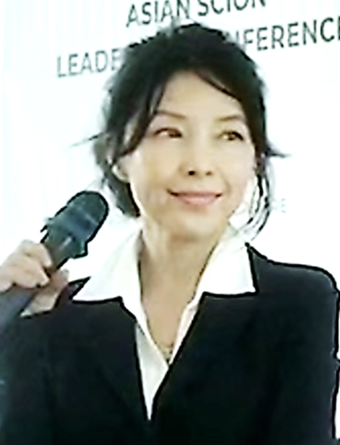
FORTUNE 500 & ENTREPRENEURIAL LEADER
In Finance, Strategy, Business Development, Transformation
Isabella is an accomplished international finance and business leader with > 20 years of leadership experiences with leading MNCs including Microsoft, Unilever, Energizer, Diageo, BAT, Boston Scientific.
She has managed 6 complex regions spanning over 40 countries, leading Finance, Strategy, Transformation, Business Process, Governance, and Consulting.
Isabella has strong experience in formulating and operationalize strategies, driving execution in collaboration with diverse stakeholders globally to deliver target result. She has a track record of success driving profitable growth, turnarounds, investment priorities, transforming strategies, systems, processes, and capabilities for the world’s top-tier companies.
In her consulting roles, Isabella partners with global teams to scale operations, guide strategies and execution, build operational structure and capability.
Isabella is an APAC expert with on-the-ground experience in multiple markets, multilingual (Mandarin, Cantonese, English, Bahasa Indonesia). Leveraging her knowledge and network, she has helped companies set up and scale international business using Singapore as an international gateway.
Isabella Lan
https://www.linkedin.com/in/isabellalan/

Slide 16
